Slide 1
IT 206: Object-Oriented Techniques for IT Problem Solving
Method Overriding

Slide 2
Overriding Superclass Methods
Sometimes you may want to reuse a method in a subclass from a superclass
If you need to change how a method works:
Write a new, more specialized method in the subclass
Use the same formal declaration as the superclass method you want to replace
It must contain the same name and formal parameters
This will override (and hide) the superclass method
The superclass method can still be called using the super keyword
Note: You cannot do super.super. to back up two levels
The new method will be invoked with the same method name when it is called on a subclass object
A subclass can override a method of the superclass by providing a new implementation.

Slide 3
Overriding Superclass Methods (Cont'd)
Polymorphism – Using the same method name to indicate different implementations
Means "many forms"
Each subclass method overrides the method that has the same name in the superclass

Slide 4
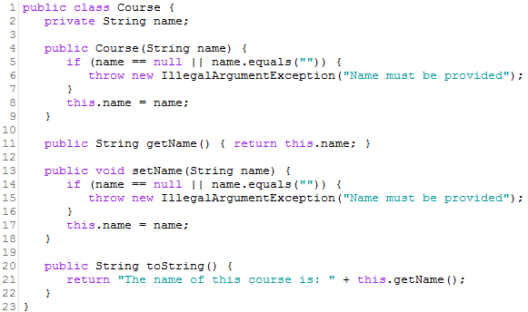
Example: Simple Method Override
Assume there are two types of courses – undergraduate and graduate
Each type of course has a name, but has different behaviors, such as how the courses are output
Note: toString() in the superclass. The method will be overridden in subclasses

Slide 5
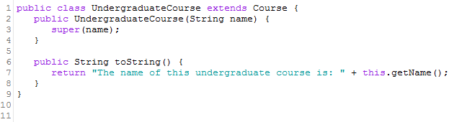
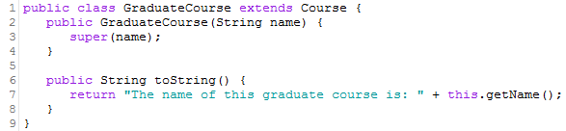
Example: Simple Method Override (Cont'd)
Note: Each subclass has its own implementation of toString()
When calling the method in the subclass it will override the behavior in the superclass
Subclass accessing public interface methods of superclass

Slide 6
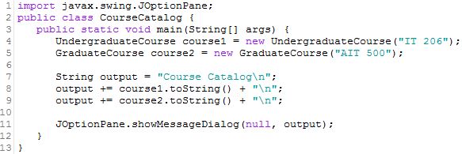
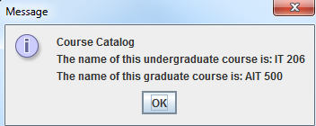
Example: Simple Method Override (Cont'd)
Implementation

Slide 7
Common Error: Forgetting about super
Assume Manager inherits from Employee
getSalary is an overridden method of Employee
Manager.getSalary includes an additional bonus
public class Manager extends Employee {
. . .
public double getSalary() {
double baseSalary = this.getSalary(); // Manager.getSalary
// should be super.getSalary(); // Employee.getSalary
return baseSalary + this.getBonus();
}
}

Slide 8
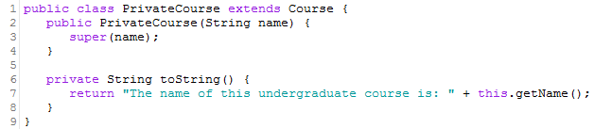

Common Error: More Restrictive Access Modifiers
If a superclass has a method that is public:
An overridden method in the subclass must not be more restrictive
Overriden method may not be protected or private
Must also be public
Otherwise you will cause a syntax error
Why?
Through inheritance, an "is-a" relationship means all subclass objects must be able to respond to method calls to public methods in the superclass
Once a method is declared public in a superclass, it must remain public for all direct and indirect subclasses

Slide 9
Methods You Cannot Override
There are three types of methods you cannot override in a subclass
private methods
They are intended to be private and not inherited
static methods
They are intended to be static to the class they are created – only one copy for all instances (objects)
final methods
A method declared final means it cannot be overridden
Classes can be declared as final too!
A class that is declared as final cannot be overridden
This is done on purpose as a design decision

Slide 10

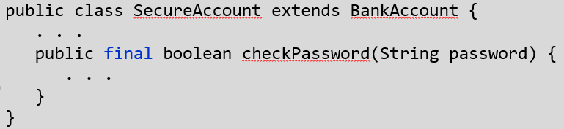
More on Final Methods and Classes
You can prevent programmers from creating subclasses and override methods using final
Example of a class that cannot be overridden
Example of a method that cannot be overriden

Slide 11
Common Error: Overloading vs. Overriding
Overloading – two methods share the same name, but have different formal parameters (number, type, and/or order) in the method header
Overriding – a subclass declares a method with the same name and exactly the same parameters as the superclass method
If you intend to override, but have different formal parameters, you will be overloading the inherited method, not overriding it!

Slide 12
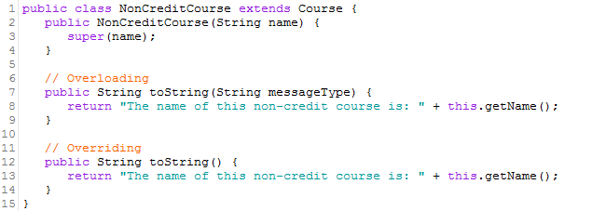
Common Error: Overloading vs. Overriding (Cont'd)

Slide 13
Instance Variables in Inheritance
Can't override variables
All non-private variables are inherited from the superclass
Private variables can be accessed through methods within the public interface of the superclass
To make a new variable available that doesn't exist in the superclass, add it to the subclass
What if you define a new variable with the same name as a super class variable?
Each instance would have two variables of the same name
Fields can hold different values
Legal, but logically very confusing! (Don't do it)

Slide 14

References
A superclass object reference value may reference a subclass object
Why? Polymorphism!
Helps add a layer of abstraction
Example:
A subclass object reference value may not reference a superclass object
Example:

Slide 15
Questions?

Slide 16
Case Study: Creating a Set of Bank Accounts

Slide 17
Problem
You have been tasked to design software for IST Savings and Loan. The bank offers two types of bank accounts: Checking and Savings. Both accounts have common features, such as depositing money All accounts have a name and a balance. Distinctions between the accounts are as follows:
Checking Account
A maximum of 1000 checks can be written
Withdrawals can only happen by writing a check
The customer can see the name of the account, balance, and individual amounts of each check written for all checks at any time
Savings Account
Each deposit receives a 1% deposit bonus
Customers can only make up to 6 withdrawals per month
The bank needs the ability to signify a new month
The customer can see the name of the account, balance, and number of withdrawals made in the current month at any time
Create a program that demonstrates a customer with both a checking and savings account

Slide 18
Where to Start? Define the Problem
Make sure you understand what is being asked. View the nouns and verbs in the problem statements
Nouns – Object or object property
Verbs – methods
Figure out the common attributes and activities
Reuse is key!

Slide 19
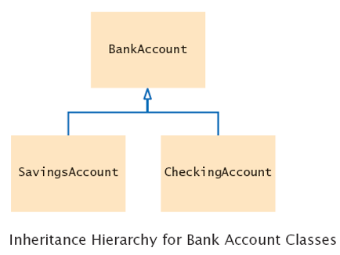
Inheritance Hierarchy
This problem will use an inheritance hierarchy

Slide 20
Design a Solution – UML Class Diagram
Before creating the full class diagram with descriptions, you may find it helpful to create a map that shows all instance variables and methods
BankAccount (name, initialBalance)
BankAccount
name
balance
validateTransactionAmount()
getBalance()
toString()
getName()
setBalance(balance)
withdraw(amount)
deposit(amount)
setName(name)

Slide 21
Design a Solution – UML Class Diagram (Cont'd)
Methods
Inherit:
getName
getBalance
setName
setBalance
deposit
withdraw
Override:
toString
Add:
getCheck
getNumChecks
writeCheck
Variables
Inherit:
name
balance
Add:
checks
numChecks
MAX_NUM_CHECKS
CheckingAccount
CheckingAccount(name, balance)
getCheck(index)
checks[]
numChecks
MAX_NUM_CHECKS
toString()
getNumChecks()
writeCheck(amount)

Slide 22
Design a Solution – UML Class Diagram (Cont'd)
Methods
Inherit:
getName
getBalance
setName
setBalance
deposit
withdraw
Override:
toString
deposit
withdraw
Add:
getNumWithdrawals
setNumWithdrawals
endMonth
Variables
Inherit
name
balance
Add
numWithdrawals, DEPOSIT_BONUS, MAX_NUM_WITHDRAWALS
SavingsAccount
getNumWithdrawals()
SavingsAccount(name, balance)
DEPOSIT_BONUS
MAX_NUM_WITHDRAWALS
numWithdrawals
endMonth()
deposit(amount)
setNumWithdrawals
(numWithdrawals)
toString()
withdraw(amount)

Slide 23
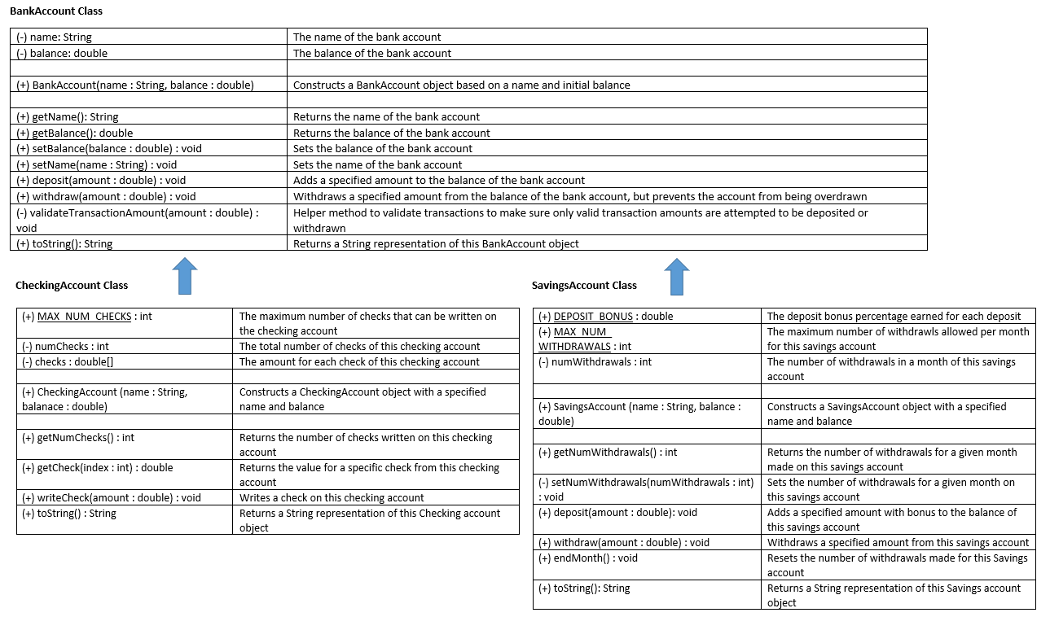
Design a Solution – UML Class Diagram (Cont'd)

Slide 24
Design a Solution – Object Map

Slide 25
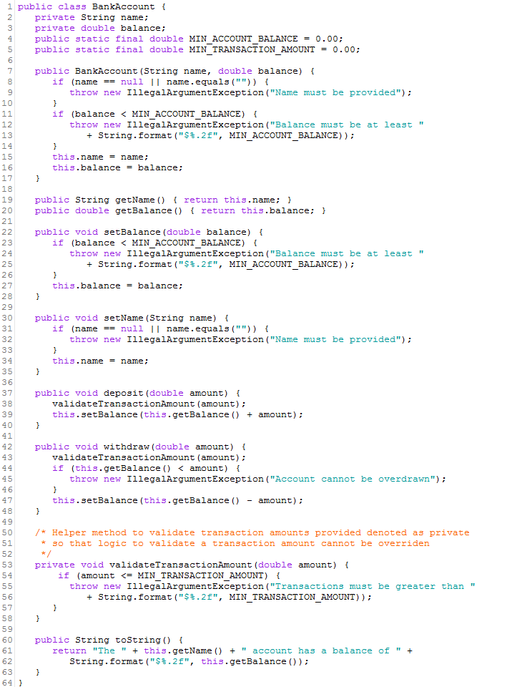
Implement the Solution – Data Definition Class: (Superclass) BankAccount

Slide 26
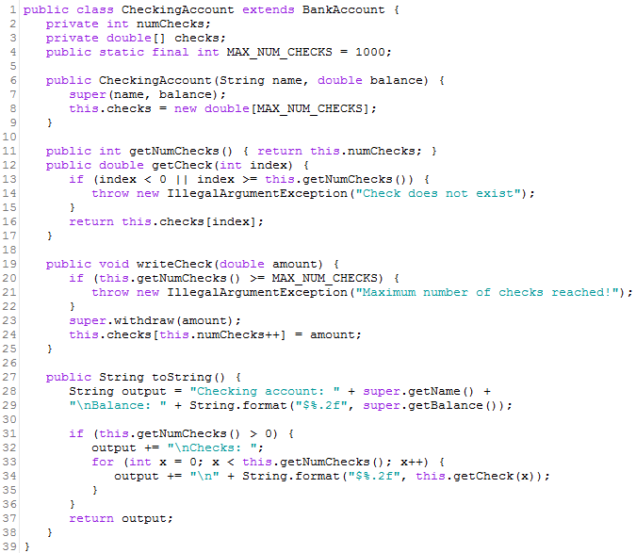
Implement the Solution – Data Definition Class: (Subclass) Checking Account

Slide 27
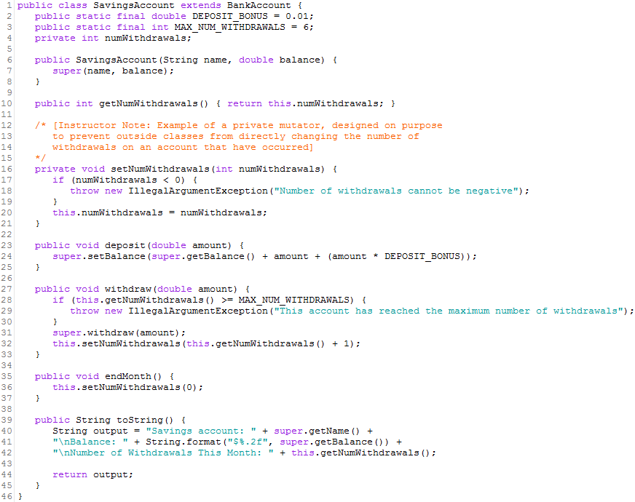
Implement the Solution – Data Definition Class: (Subclass) Savings Account

Slide 28
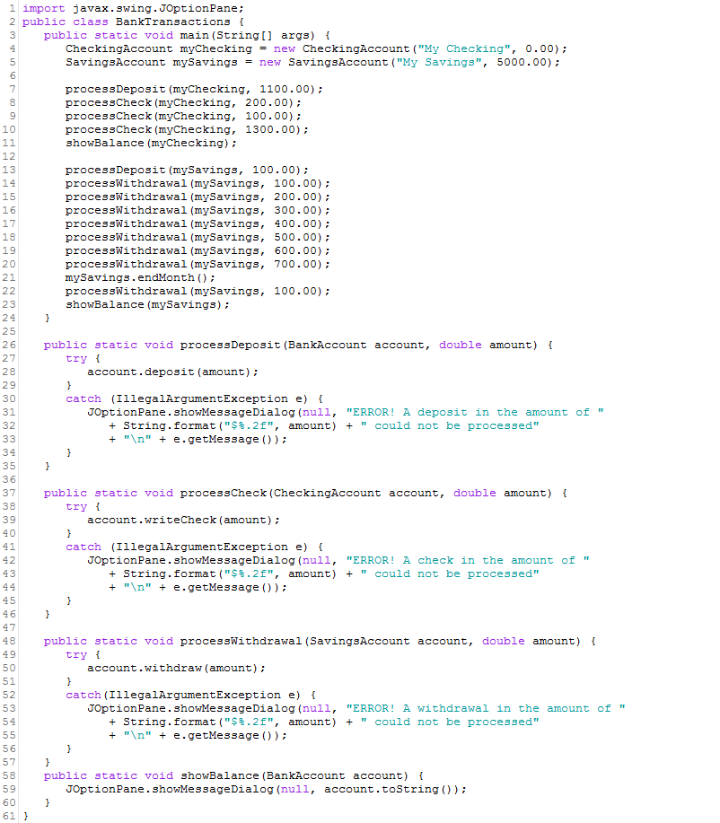
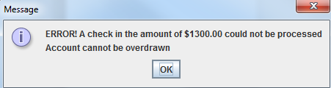
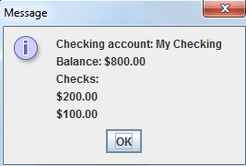
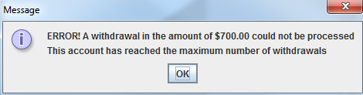
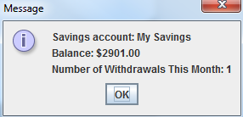
Implement the Solution – Implementation Class

Slide 29
Questions?

